Slide 1
Future Skills and Web Technologies
A Comprehensive Guide to Key Concepts and Emerging Careers

Slide 2
Overview of Future Skills Sub-sector
The Future Skills sub-sector equips individuals with digital competencies essential for the modern workforce. Key areas include digital literacy, data science, artificial intelligence (AI), cybersecurity, and cloud computing, which are essential for adapting to the ongoing digital transformation across industries.

Slide 3
Occupations in the Future Skills Sub-sector
- **Data Analysts & Data Scientists**: Analyze complex data to drive decision-making.
- **AI & Machine Learning Specialists**: Develop algorithms that enable computers to learn from data and make decisions.
- **Cybersecurity Analysts**: Protect data and systems from cyber threats.
- **Software Developers**: Create applications and software solutions for various platforms.
- **Digital Marketing Specialists**: Use online channels to promote brands effectively.
- **Web & App Developers**: Build and maintain websites and mobile applications.

Slide 4
Key Trends in Future Skills Sub-sector
- **Increased Demand for Data Skills**: Data-driven decision-making is rising across industries.
- **Expansion of Cybersecurity Roles**: Cyber threats are creating more demand for security roles.
- **Growth in Automation and AI**: AI is transforming how tasks are automated.
- **Emphasis on Remote Work Skills**: Remote work tools and IT support are increasingly essential.
- **Universal Digital Literacy**: Digital skills are now crucial across sectors.

Slide 5
Roles in Digital Literacy & Information Technology
- **Digital Literacy Trainers**: Teach basic digital skills to those needing essential tech knowledge.
- **IT Technicians**: Maintain IT infrastructure and provide troubleshooting services.
- **Network Administrators**: Manage network systems to ensure stability and security.
- **Software Engineers**: Design and develop software solutions.
- **Data Protection Officers**: Implement and monitor data protection policies.

Slide 6
Overview of Web Technologies
Web technologies encompass tools and techniques used for developing websites and web applications, forming the backbone of the internet. They enable seamless online interactions and are fundamental to creating user-friendly sites and applications.

Slide 7

Internet Basics
The internet connects devices globally, allowing data sharing and communication. The World Wide Web, part of the internet, is an interconnected system of websites and online services. Protocols like HTTP and HTTPS structure data transmission across the web.

Slide 8
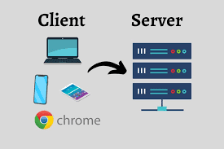
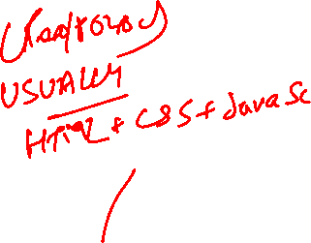
Client-Server Model
This model enables communication between clients (browsers) and servers (remote computers). Clients request information, and servers process and respond. It’s foundational for web experiences, where users request data from servers in real-time.

Slide 9

HTML (Hypertext Markup Language)
HTML is the primary markup language for structuring web content. It uses tags to create elements like headers, paragraphs, and links, forming the layout of websites. HTML is essential for organizing web content and is often paired with CSS and JavaScript for enhanced functionality.

Slide 10

CSS (Cascading Style Sheets)
CSS is a style sheet language that defines the visual presentation of web pages, including layout, colors, and fonts. It enables responsive design, adjusting content to different screen sizes and enhancing the user experience.

Slide 11

JavaScript
JavaScript is a programming language that enables dynamic, interactive web content. It powers features such as animations, form validation, and real-time updates, enhancing user engagement. JavaScript runs on the client-side, providing fast, responsive user interactions.

Slide 12
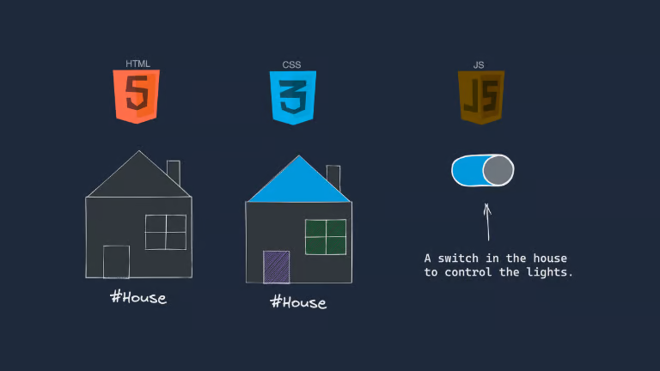

Slide 13
Web Development Frameworks & Libraries
Frameworks like React, Angular, and Vue simplify development by providing pre-built components. They allow efficient and scalable application development, with front-end frameworks supporting user interfaces and back-end frameworks (e.g., Node.js) managing server operations.

Slide 14
Web Hosting and Domain Names
Web hosting services store websites, making them accessible on the internet. Domain names (e.g., www.example.com) act as web addresses. Hosting options include shared hosting for small sites, dedicated servers, and cloud hosting for larger sites.

Slide 15
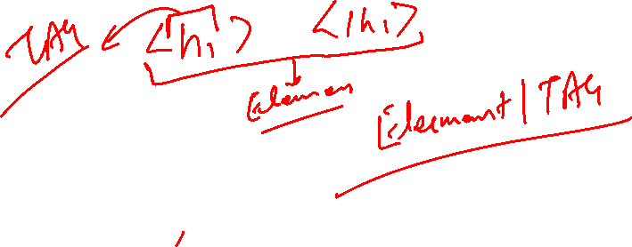
HTML : Hyper Text Mark Up Language
Any Browser Mostly get response which includes 3 files.
i.e HTML + CSS +Java Script and render the page
Hyper Text : Pieces of text link to Other page.
https://info.cern.ch/hypertext/WWW/TheProject.html
Mark Up :
“My Name is Rahul”

Slide 16
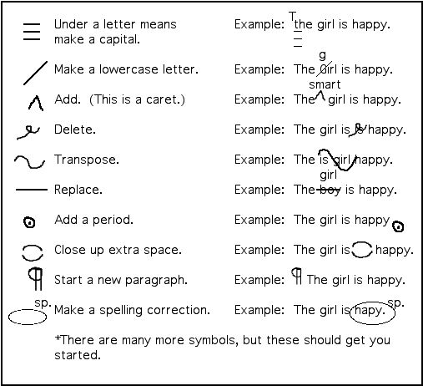

Slide 17
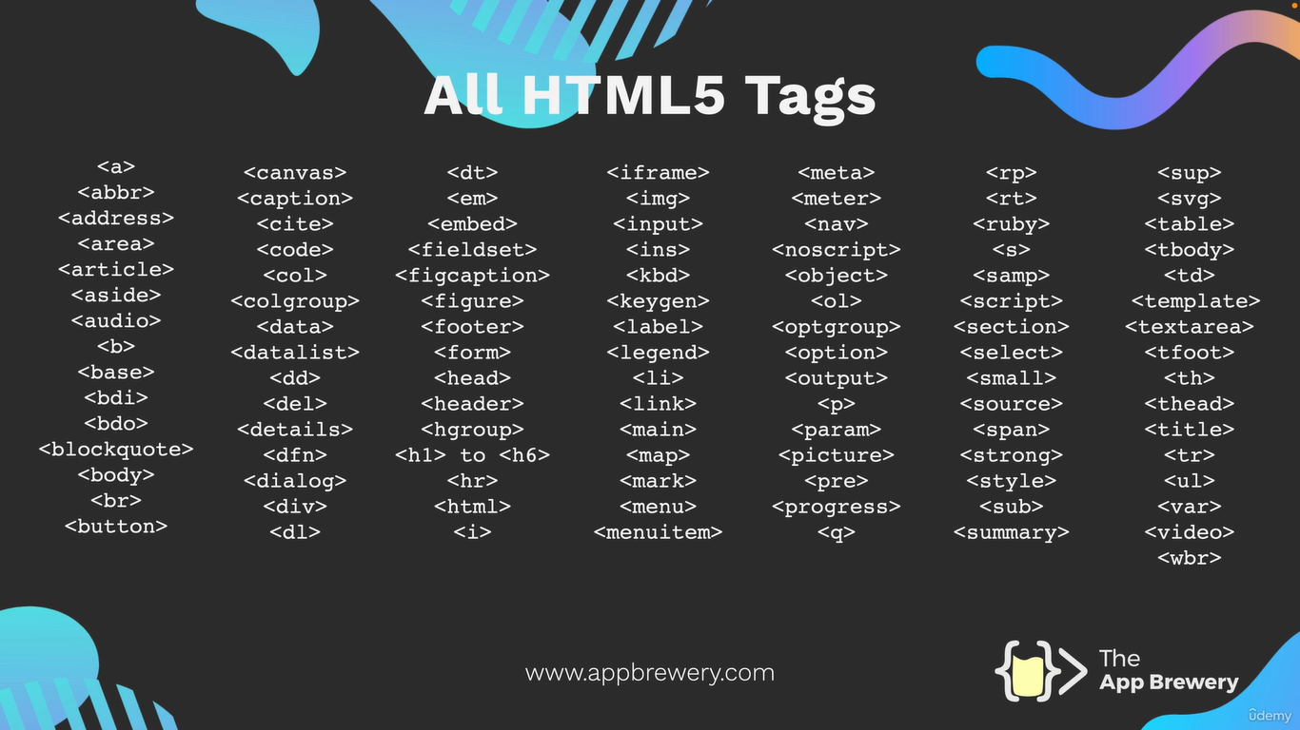
How we do Mark Up In HTML? Using HTML Tags

Slide 18

HTML TAG Links
Mark Up Done in HTML page by using tags
Initially : https://www.w3.org/History/19921103-hypertext/hypertext/WWW/MarkUp/Tags.html
Now : https://www.w3schools.com/tags/tag_html.asp

Slide 19
Tool
VS Code : https://code.visualstudio.com/
Install Visual Studio Code Extensions
Extensions are like plugins that extend the functionality of VSCode. Here are the ones that I've installed. Click on the link and then click on the "install" button and it should automatically install it in your VSCode application.
Live Preview
Prettier
vscode-icons
Chrome : https://www.google.com/intl/en_uk/chrome/

Slide 20
Tags
Meta Tags : Metadata is data (information) about data. Metadata is used by browsers (how to display content or reload page), search engines (keywords), and other web services.
<head> <meta charset="UTF-8"> <meta name="description" content="Free Web tutorials"> <meta name="keywords" content="HTML, CSS, JavaScript"> <meta name="author" content="John Doe"> <meta name="viewport" content="width=device-width, initial-scale=1.0"> </head>
The viewport is the user's visible area of a web page. It varies with the device - it will be smaller on a mobile phone than on a computer screen.

Slide 21
Tags
Text Tags : Formatting elements were designed to display special types of text:
<b> - Bold text
<strong> - Important text
<i> - Italic text
<em> - Emphasized text
<mark> - Marked text
<small> - Smaller text
<del> - Deleted text
<ins> - Inserted text
<sub> - Subscript text
<sup> - Superscript text

Slide 22
Tags
Image & object Tags : The <object> tag defines a container for an external resource.
The external resource can be a web page, a picture, a media player, or a plug-in application.
<object data=“image_url" width="300" height="200"></object>
To embed a picture, it is better to use the <img> tag.
To embed HTML, it is better to use the <iframe> tag.
To embed video or audio, it is better to use the <video> and <audio> tags.

Slide 23
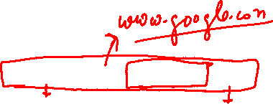
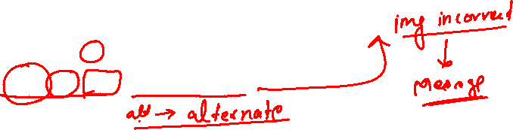
Element | Tag
Heading Tag : <h1> to <h6>
Paragraph : <p> </p>
List :
Ordered : <ol></ol>
UnOrdered : <ul></ul>
Anchor Element : <a href = “Url”>Content </a>
Images : <img src=“url” alt=“message”>

Slide 24
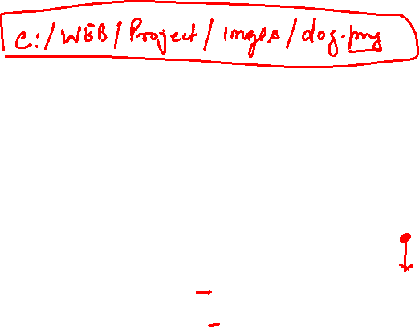
File Path
Absolute Path : An absolute path is the complete address of a file or directory on a computer system, starting from the root directory.
Relative path: relative path is a way to specify the location of a file or directory in relation to the current working directory.
For upper directory : ../cat.png
For current directory : ./dog.png

Slide 25
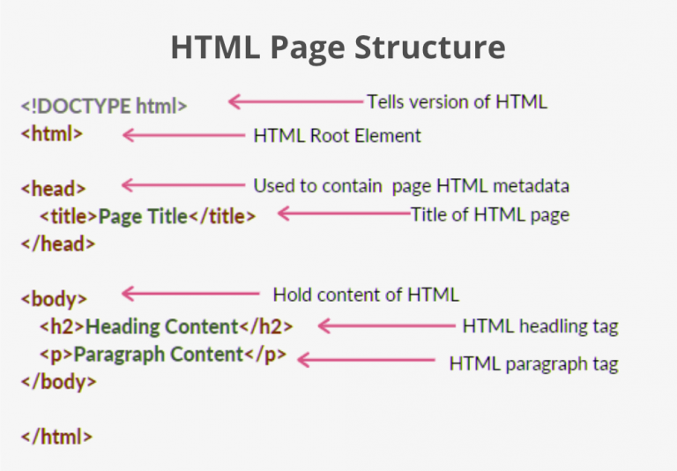
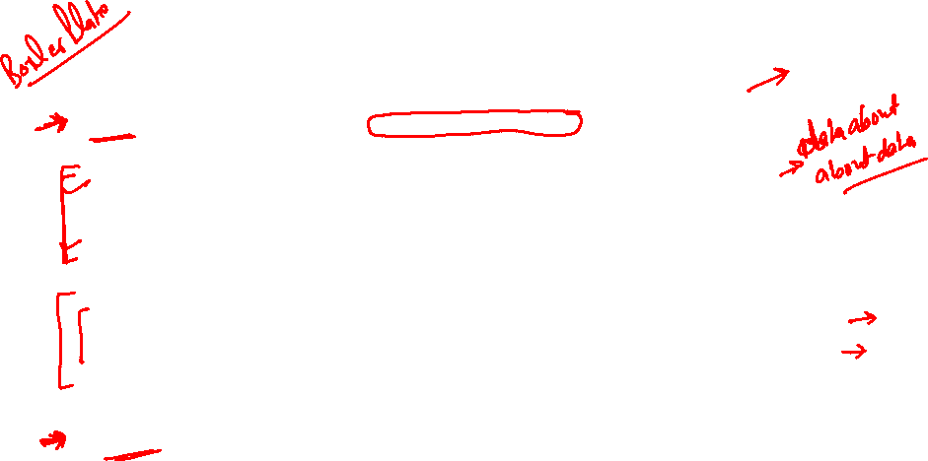
HTML Boiler Plate

Slide 26
Hosting Your Website Using Git

Slide 27
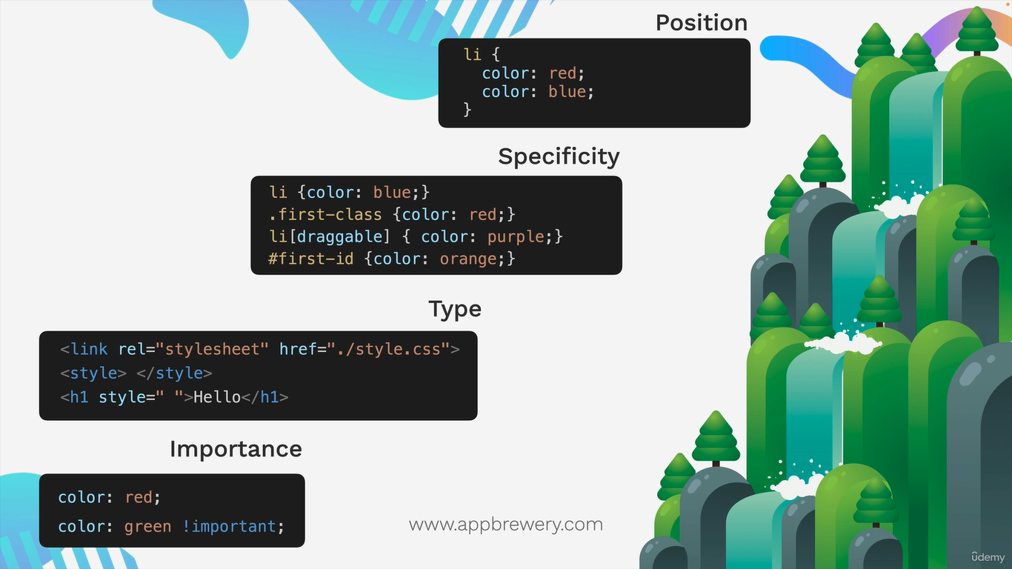

Slide 28
Group : apply on both selector
h1, body{
color: brown;
font-style: initial;
font-family: Cambria, Cochin, Georgia, Times, 'Times New Roman', serif;
}

Slide 29
Child : Apply to direct child of left side
Selector1 > selctor2 {
rules
}
Decendent : Apply to all descendent of left side
Selector1 selctor2 {
rules
}

Slide 30
Chaining :apply where all selector are true
Selecto1selector2{}

